Slide 1
Unveiling Customers Perspective
Analysing Airline Reviews with Python Web Scraping

Slide 2
Introduction
Welcome to the presentation on extracting insights from airline reviews using Skytrax data.
We’ll focus on scraping reviews and highlighting the importance of comprehensive data for informed analysis.
The success of our exploration lies in meticulous data collection, enriching our understanding of customer sentiments and experiences.

Slide 3
Analysis of the Scrapped Reviews Dataset
The data collected from web scraping encompasses various columns, offering insights into diverse aspects of the airline. Key columns include:
AuthorName: Name of the review author. ReviewBody: Detailed content of the review. RatingValue: Numeric rating given by the reviewer. RatingMax: Maximum possible rating. ReviewTitle: Title or summary of the review. DatePublished: Date when the review was published. Sentiment: Numeric sentiment score derived from the review. | Aircraft: Type of aircraft used for the flight. Type Of Traveller: Description of the traveller type (e.g., Solo Leisure). Seat Type: Type of seat experienced (e.g., Business Class). Route: Flight route or journey details. Date Flown: Date when the flight took place. Recommended: Indicates whether the reviewer recommends the airline (yes/no).

Slide 4
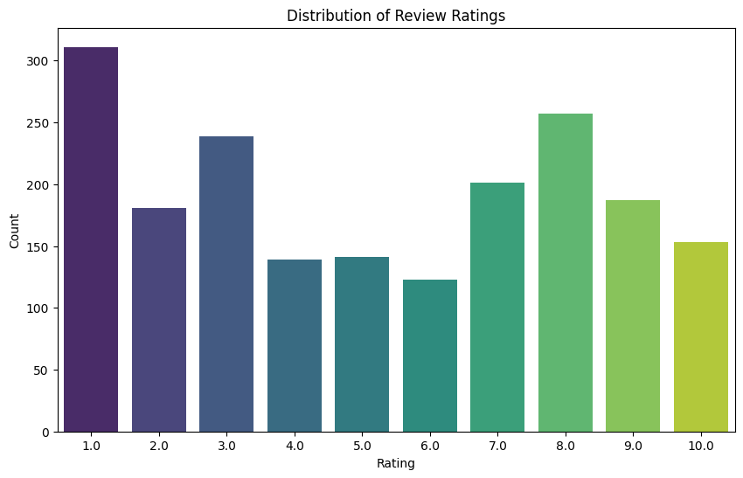
Overall Average Rating
The distribution is right-skewed, meaning that there are more low ratings (1.0 to 4.0) compared to high ratings (7.0 to 10.0). This suggests that a significant number of individuals tend to give lower ratings.
Potential Areas for Improvement: Seat types receiving consistently low ratings (1.0 to 4.0) may need to address specific issues to enhance customer satisfaction.

Slide 5
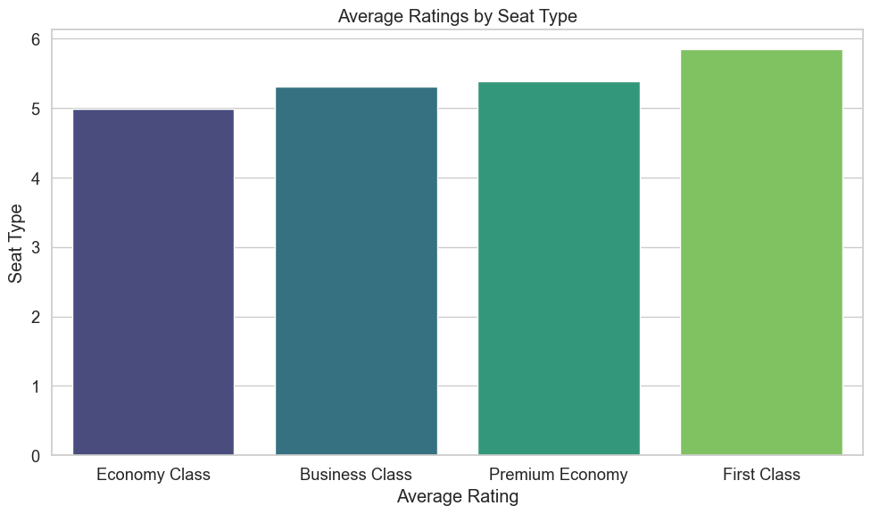
Average Rating By Seat
Economy Class: 2.0 | Business Class: 8.0 | Premium Economy: 6.0 | First Class: 7.0
Business Class has the highest average rating (8.0), followed by First Class (7.0) and Premium Economy (6.0).
Economy Class has the lowest average rating (2.0), indicating room for improvement.
Addressing Economy Class issues and maintaining high standards in Business Class are key for passenger satisfaction.

Slide 6
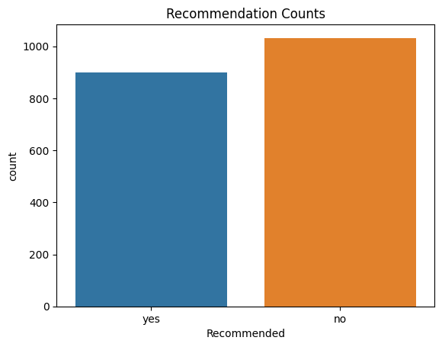
Overall Recommendation Analysis
Yes: 900 | No: 1032
Potential Areas for Improvement
Recommended: Yes: There are 900 instances where a recommendation was given. These passengers likely had a positive experience or found the service satisfactory.
Recommended: No: There are 1032 instances where no recommendation was given. This suggests that these passengers might not have been satisfied or encountered issues during their experience.

Slide 7
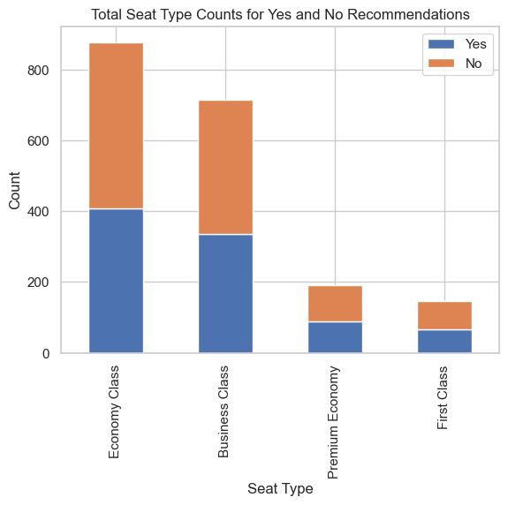
Seat Type Recommendation Analysis
Recommended Seat Type | Yes: 900 | No: 1032
Business Class | 336 | 380
Economy Class | 408 | 471
First Class | 66 | 80
Premium Economy | 90 | 101
The table shows the distribution of 'Yes' and 'No' recommendations for different seat types. Economy Class has the highest total reviews, while Business Class has a balanced count of 'Yes' and 'No'. First Class and Premium Economy have fewer reviews, with a relatively similar distribution of recommendations.

Slide 8
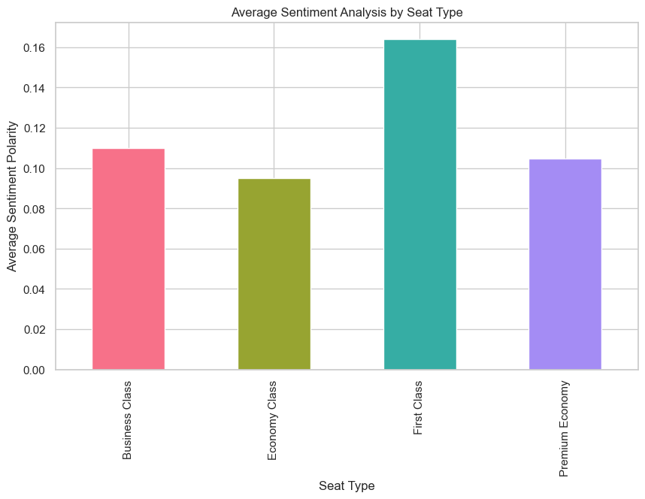
Review Sentiment Analysis
Seat Type | Average Sentiment Polarity
Business Class | 0.109959
Economy Class | 0.094883
First Class | 0.164216
Premium Economy | 0.104778
The sentiment analysis reveals that customers generally express positive sentiments in reviews for different seat types. Business Class and Economy Class have slightly positive sentiments, while First Class exhibits a higher positivity. Premium Economy also has a slightly positive sentiment. These numeric values represent the overall positivity or negativity, with higher values indicating a more positive sentiment.

Slide 9
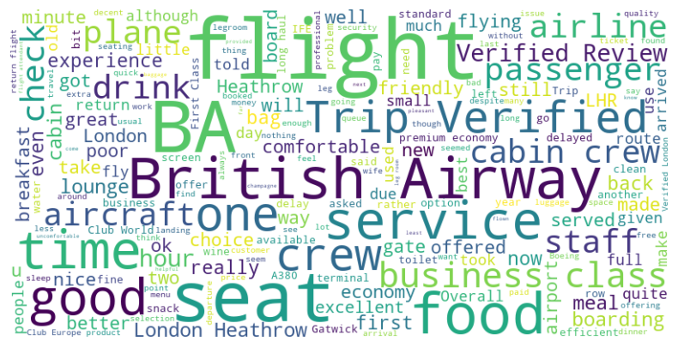
Visualising overall word and frequency analysis
Word frequency analysis reveals passenger sentiments.
1. Positive Insights:
- High frequencies for "flight," "BA," "seat," and "British Airways" indicate a focus on airline experience.
- Positive terms like "good," "excellent," and "great" reflect overall satisfaction.
2. Improvement Areas:
- Occurrences of "poor," "delay," and "problem" signal potential concerns.
- Mentions of "uncomfortable" and "legroom" highlight discomfort issues.
This analysis identifies key sentiments, aiding improvement strategies for a positive passenger experience.

Slide 10
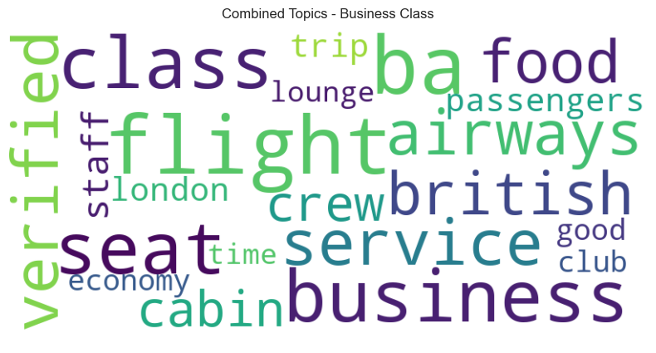
Visualising word and frequency analysis for Business Class
The combined topic for Business Class encompasses various elements of the flight experience, including service quality, cabin conditions, food, and specific features like the club lounge and seating.
Terms like "ba," "British Airways," and "verified" indicate a focus on reviews related to the airline, and the repetition of "flight" suggests a central theme around the in-flight experience. The presence of "verified" may imply an emphasis on authenticated or credible reviews, providing insights into customer experiences with Business Class services.

Slide 11
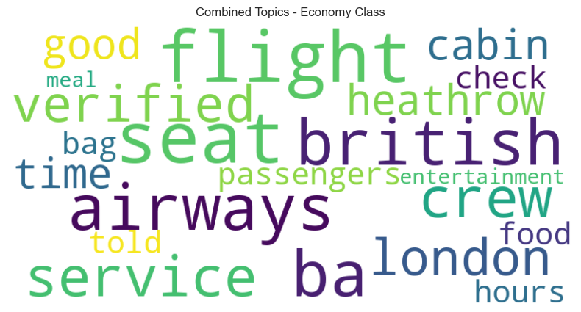
Visualising word and frequency analysis for Economy Class
The combined topic for Economy Class indicates a focus on various aspects of the flight experience, including elements like "ba," "flight," "seat," "service," and "crew," suggesting discussions around the airline, seating, and in-flight service.
Key terms like "verified," "London," "Heathrow," and "British Airways" highlight a recurring emphasis on authentication, specific locations, and the airline brand, possibly influencing reviews related to Economy Class experiences and services provided by British Airways.

Slide 12
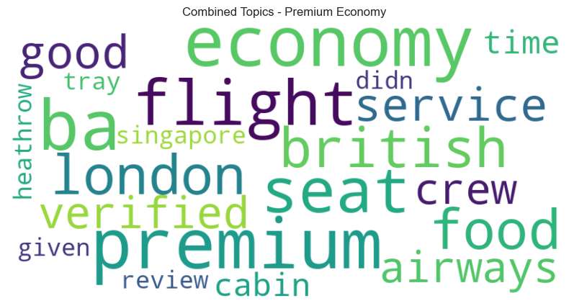
Visualising word and frequency analysis for Premium Economy Class
The combined topic for Premium Economy appears to focus on various aspects such as flight experience, cabin conditions, service quality, and food. Key terms include "economy," "flight," "Premium," "seat," "food," "cabin," "service," and "London," suggesting discussions on the overall flight quality, seating comfort, and dining experience.
The repetition of terms like "BA," "British Airways," and "verified" indicates a specific focus on reviews related to the airline, possibly emphasizing authenticated or credible feedback.
The presence of location names like "Singapore" and "Heathrow" suggests insights into Premium Economy experiences on specific routes or locations.

Slide 13
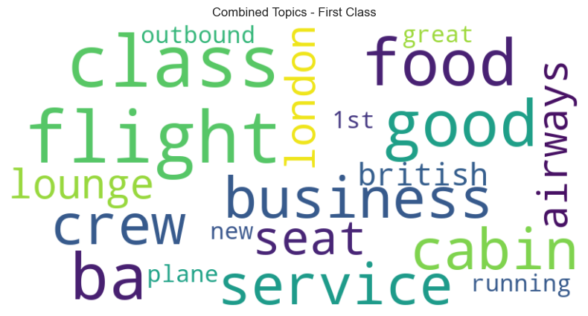
Visualising word and frequency analysis for First Class
- The combined topic for First Class revolves around various aspects of the flight experience, including "service," "crew," "cabin," "food," and "seat," indicating a focus on the premium amenities and services provided in First Class.
- Terms like "lounge," "outbound," and "London" suggest discussions about specific locations and amenities, while repeated mentions of "BA," "British Airways," and "good" may indicate positive sentiments and satisfaction with the overall First Class experience, highlighting the importance of service quality and comfort in premium travel.

Slide 14

Thank you!
.

